Slide 1

A Multiple Regression Analysis of Medical Costs
Blair Carter, Adam Winters, and Sherwin Yuen

Slide 2

Introduction:
Medical Costs Dataset from Kaggle.
Multiple regression model was a good fit.
Our goal is to create a model to describe the relationship between variables or predict future data observations.
Charges is our response variable.
Variable | Age | Sex | BMI | Children
Range | Min: 18 years Max: 64 years | Male or Female | Min: 15.96 Max: 53.13 | Min: 0 children Max: 5 children

Slide 3
Introduction Continued:
Variable | Smoker | Region | Charges
Range | Yes or No | Northwest, Northeast, Southwest, Southeast | Min: $1,122 Max: $63,770
Research allows us to predict the effects of the variables, for example increasing age and BMI should correlate to greater medical charges as they leave patients at a greater risk of disease and injury.
To determine the significance of explanatory variables, check model assumptions, and check for multicollinearity we will utilize:
Stepwise regression
Best subset of predictors
AIC and BIC
Diagnostic plots and transformations
VIF

Slide 4
Full Model:

Slide 5
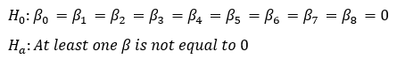
Stepwise Regression:
βi | Coefficient | p - value
β₀ | -11938.5 | 0
β₁ | 256.9 | 0
β₂ | -131.3 | 0.693348
β₃ | 339.2 | 0
β₄ | 475.5 | 0.000577
β₅ | 23848.5 | 0
β₆ | -353.0 | 0.458769
β₇ | -1035.0 | 0.030782
β₈ | -960.0 | 0.044765
Fcalc = 500.8
p - value = 0
Reject H₀
There is significant evidence to conclude that at least one β does not equal 0 at the 5% significance level.

Slide 6
Best Subset of Predictors:
age | sex | bmi | children | smoker | region | R²adj
no | no | no | no | yes | no | 0.6195
yes | no | no | no | yes | no | 0.7210
yes | no | yes | no | yes | no | 0.7469
yes | no | yes | yes | yes | no | 0.7489
yes | no | yes | yes | yes | yes | 0.7496
yes | yes | yes | yes | yes | yes | 0.7494
R²adj
Model without sex had the highest R²adj.

Slide 7
Best Subset of Predictors Continued:
age | sex | bmi | children | smoker | region | Cp
no | no | no | no | yes | no | 694.7395
yes | no | no | no | yes | no | 154.4620
yes | no | yes | no | yes | no | 17.3321
yes | no | yes | yes | yes | no | 7.5013
yes | no | yes | yes | yes | yes | 3.1556
yes | yes | yes | yes | yes | yes | 5.0000
Cp
Model without sex had the smallest Cp that was close to the number of parameters in the full model.

Slide 8
AIC and BIC
Parameters | AIC | BIC
Full model | 27115.51 | 27167.50
Model without sex | 27113.66 | 27160.45
The model without sex has a lower AIC and BIC, and is therefore better.

Slide 9
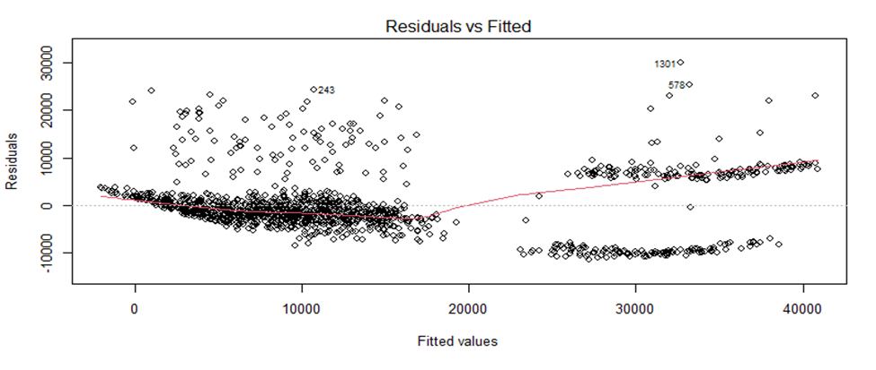
Diagnostic Plots: Residuals Vs. Fitted

Slide 10
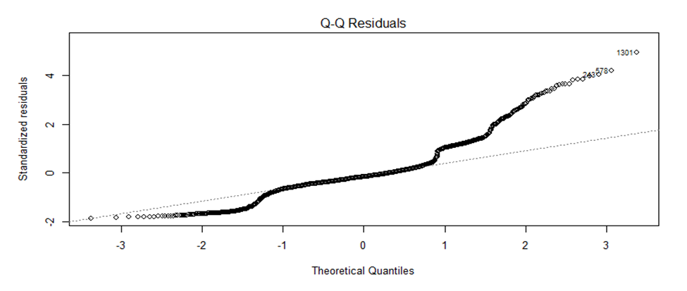
Diagnostic Plots: Q – Q Residuals

Slide 11
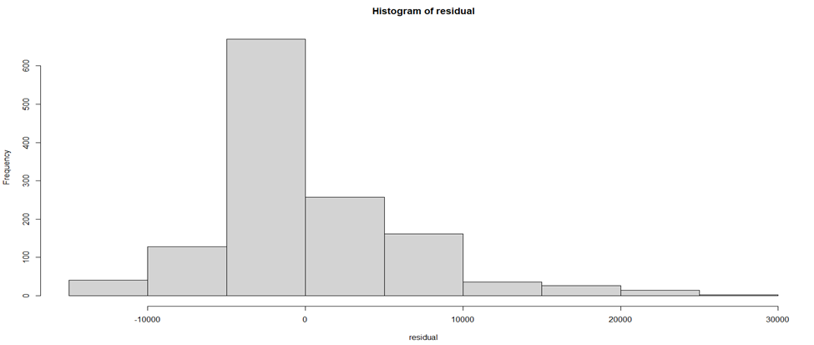
Diagnostic Plots: Histogram of Residuals

Slide 12
Diagnostic Plots:
In the Residuals vs. Fitted plot, the dots are not randomly spread around the zero line indicating that the variances are not constant.
In the Q – Q Residuals plot, the dots do not follow the straight line indicating the model does not follow normal distribution.
The histogram of residuals is slightly right skewed which also indicates the model does not follow normal distribution.
Since these plots indicate that the model may not fit the data properly in terms of its variance and normality, we will try a transformation to fix this issue.

Slide 13
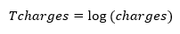
Transformed Model:
We will transform the response variable, charges to log(charges).
After completing an analysis of the transformed model using stepwise regression, best subset of predictors, AIC, and BIC, it was determined that sex was significant and should be included.

Slide 14
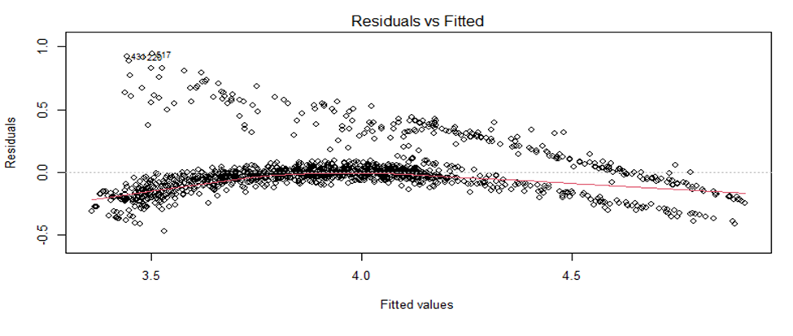
Diagnostic Plots of Transformed Model: Residuals Vs. Fitted

Slide 15
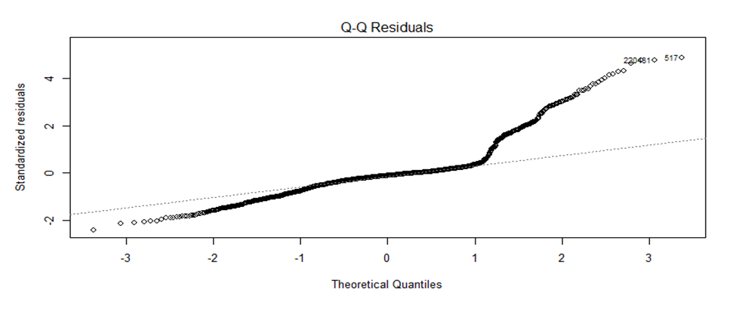
Diagnostic Plots of Transformed Model: Q – Q Residuals

Slide 16
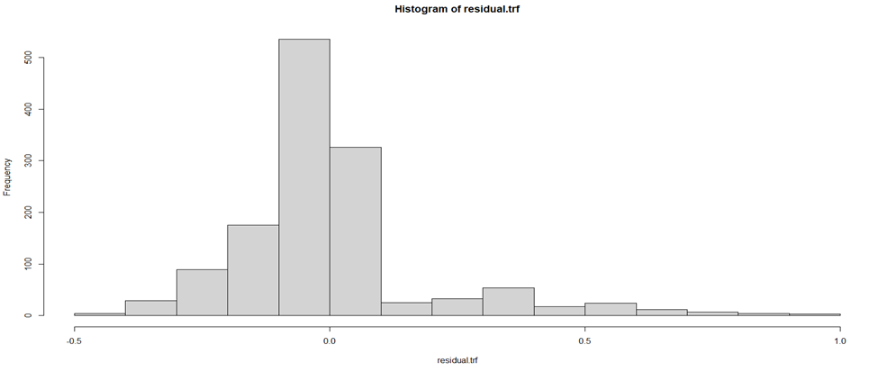
Diagnostic Plots of Transformed Model: Histogram of Residuals

Slide 17
Diagnostic Plots of Transformed Model:
While the transformation seems to have had a positive effect, the new model still does not properly fit the data, and the normality and variance is questionable. Further manipulation of the variables may correct this.
We will try to square root the bmi, age, and children variables and see if it improves the fit of the model, and should be incorporated into the final model.
To see if these transformations improve the model, we will use AIC and BIC to compare with the transformed model.

Slide 18
AIC and BIC of Transformed Model:
Parameters | AIC | BIC
Transformed model | -594.8374 | -542.8481
Transformed model including √bmi | -596.9660 | -544.9767
Transformed model including √bmi and √age | -607.9463 | -555.9570
Transformed model including √bmi, √age and √children | -608.7604 | -556.7711

Slide 19
AIC and BIC of Transformed Model:
According to the AIC and BIC, the square root of bmi, age, and children improve the fit of the model, and therefore should be incorporated into the final model.
The final model:

Slide 20
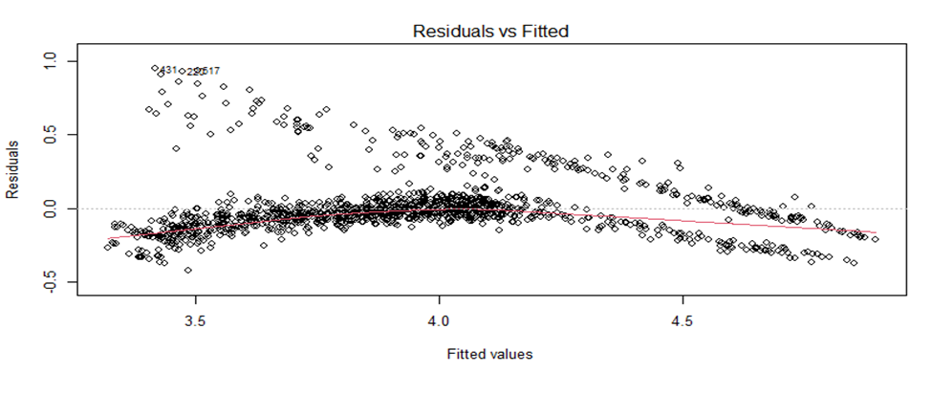
Diagnostic Plots of Final Model: Residuals Vs. Fitted

Slide 21
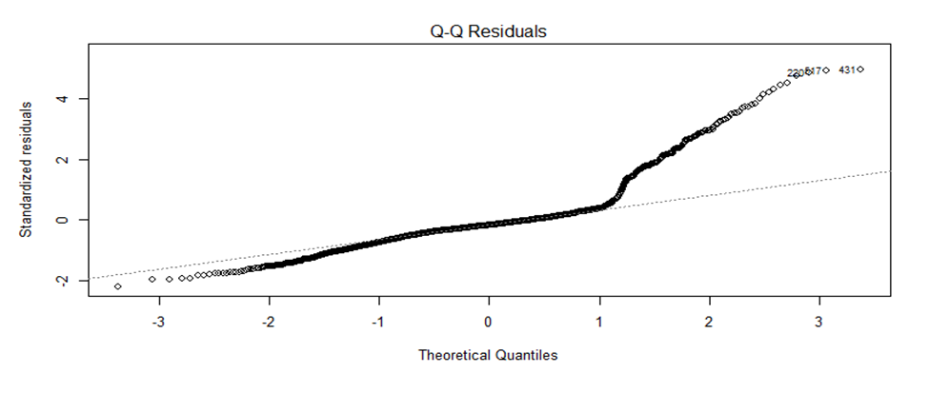
Diagnostic Plots of Final Model: Q – Q Residuals

Slide 22
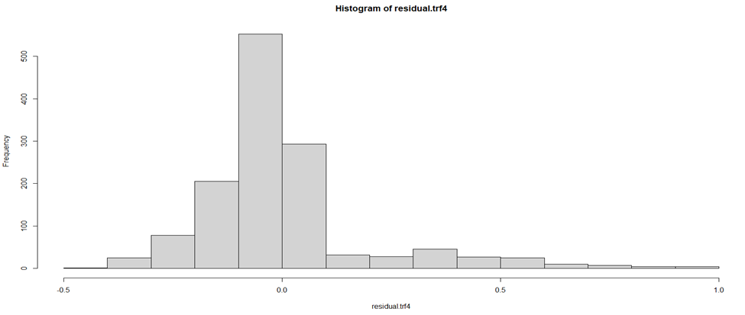
Diagnostic Plots of Final Model: Histogram of Residuals

Slide 23
Diagnostic Plots of Final Model:
In the Residuals vs. Fitted plot, the dots are not evenly spread around the zero line, indicating that the variance is not constant. The distinct cone shape we see points towards heteroscedasticity in the model. However, it is an improvement in comparison to the previous models.
In the Q – Q Residuals plot, the points near the center of the plot do align along a straight line, but there are large discrepancies at either end of the plot. This indicates that the model may not follow normal distribution.
The histogram is right skewed, which is further evidence that the model may not properly follow normal distribution.

Slide 24
Multicollinearity Check:
VIF:
All VIF values are near 1, and therefore it is unlikely that there is multicollinearity between variables in the model.
√age | √bmi | sex | √children | smoker | region
1.021085 | 1.103236 | 1.008906 | 1.008112 | 1.012173 | 1.095345

Slide 25
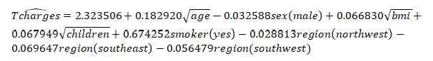
Final Regression Model:
Final model with coefficients:

Slide 26
Interpretation of the Coefficients:
√Age: If all other variables are kept constant, an increase in √age by 1 will result in the natural logarithm of charges increasing by 0.182920.
√BMI: If all other variables are kept constant, an increase in √bmi by 1 will result in the natural logarithm of charges increasing by 0.066830.
Sex: If all other variables are kept constant, the natural logarithm of charges for a man will be lower than a woman by 0.032588.
√Children: If all other variables are kept constant, an increase in √children will result in the natural logarithm of charges increasing by 0.067949.
Smoker: If all other variables are kept constant, the natural logarithm of charges for a smoker will be higher than a non-smoker by 0.674252.

Slide 27
Interpretation of the Coefficients Continued:
Region:
Northwest: If all other variables are kept constant, the natural logarithm of charges for a patient living in the northwest region will be lower than a patient living in the northeast region by 0.028813.
Southeast: If all other variables are kept constant, the natural logarithm of charges for a patient living in the southeast region will be lower than a patient living in the northeast region by 0.069647.
Southwest: If all other variables are kept constant, the natural logarithm of charges for a patient living in the southwest region will be lower than a patient living in the northeast region by 0.056479.

Slide 28

Conclusion:
The goal to create a regression model to describe or predict the medical costs for a patient was met, but further work is needed to develop a model with a better fit.
The graphs show that there is heteroskedasticity and the residuals do not meet the assumptions that they follow a normal distribution.
Possible solutions could be further transformations, redefining the response variable, or weighted regression.

Slide 29
References:
Bevans, R. (2023, June 22). Multiple linear regression: A quick guide (examples). Scribbr. https://www.scribbr.com/statistics/multiple-linear-regression/
Centers for Disease Control and Prevention. (2022, June 3). Body mass index (BMI). Centers for Disease Control and Prevention. https://www.cdc.gov/healthyweight/assessing/bmi/index.html
Cygańska, M., Kludacz-Alessandri, M., & Pyke, C. (2023). Healthcare costs and health status: Insights from the share survey. International Journal of Environmental Research and Public Health, 20(2), 1418. https://doi.org/10.3390/ijerph20021418
Huang, L. (n.d.). Chapter 1 Multiple Regression. STAT 271: Introduction to Data Analysis and Statistical Modeling.

Slide 30
References Continued:
Kane, J. (2012, October 22). Health costs: How the U.S. compares with other countries. PBS. https://www.pbs.org/newshour/health/health-costs-how-the-us-compares-with-other-countries
Pore, N. (2023, August 19). Medical_cost_dataset. Kaggle. https://www.kaggle.com/datasets/nanditapore/medical-cost-dataset
Zach. (2019, February 23). Understanding heteroscedasticity in regression analysis. Statology. https://www.statology.org/heteroscedasticity-regression/
Zach. (2020, November 16). Introduction to multiple linear regression. Statology. https://www.statology.org/multiple-linear-regression/

